Slide 1
Foundations of Data Science & Analytics DSCI 633, Fall 2021
Lecture 20
(material sources cited in last slide)
Nidhi Rastogi
Assistant Professor, GCCIS, RIT
November 02, 2021

Slide 2
Course Information
GitHub link - https://github.com/aiforsec/RIT-DSCI-633-FDS
Reach out to TA/ Instructor during office hours, via Slack, or email for any questions, suggestions, concerns, or general chat about data science.

Slide 3
Revisiting ANNs

Slide 4
An Artificial Neuron
Each hidden or output neuron has weighted input connections from each of the units in the preceding layer.
The unit performs a weighted sum of its inputs, and subtracts its threshold value, to give its activation level.
Activation level is passed through a sigmoid activation function to determine output.
w₀
w₁
Inputs
Σ
w₂
f(x)
Output
.
.
.
w_{n}
Activation function
bias
Notes:
Each network neuron (except those in the input layer) is actually a sum of all its inputs; which are in fact the outputs from the previous layer multiplied by some weights. An additional term called bias is added to this sum. And a nonlinear function known as activation function is applied to the result

Slide 5
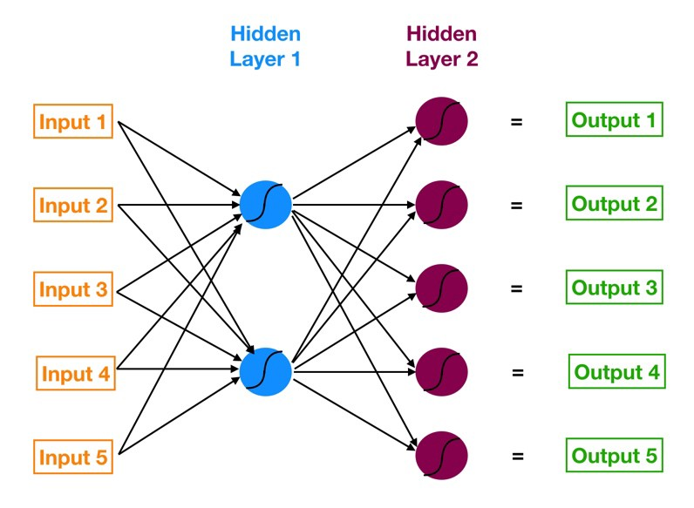
A simple ANN
Neural networks are multi-layer networks of neurons (blue, red nodes)
Used for Classification, make predictions
ANN has 3 layers of neurons:
Input layer in orange
First hidden layer in blue
Second hidden layer in red
Output layer in green
Neural network with two hidden layers

Slide 6
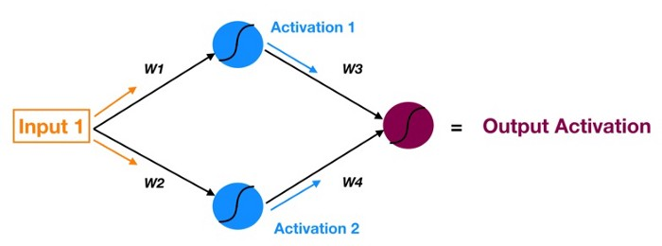
Recall Forward Propagation
Process of moving forward (propagating) through the neural network (from inputs to the ultimate output or prediction).

Slide 7
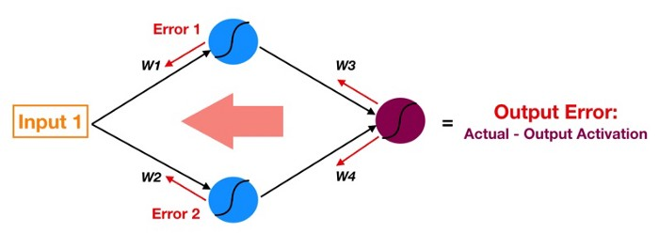
Backpropagation
- Reverse of Forward Propagation
- Except instead of signal, we are moving error backwards through our model.
Notes:
Artificial neural networks use backpropagation as a learning algorithm to compute a gradient descent with respect to weights. The algorithm gets its name because the weights are updated backwards, from output towards input.

Slide 8
Backpropagation
Follow red arrows –
- Start at output of red neuron - output activation (used for prediction) - the ultimate source of error in a model
- Move this error backwards through the model via the same weights and connections used for forward propagating the signal (instead of Activation 1, now we have Error1 — the error attributable to top blue neuron).

Slide 9
Training Deep Neural Networks

Slide 10
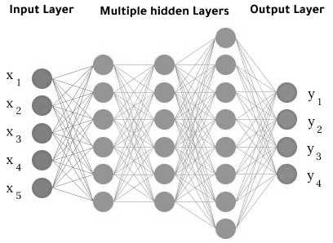
Introduction
Earlier - Introduced ANNs, trained our first deep neural networks (DNN)
However,
they were very shallow nets
with just a few hidden layers
not ideal for complex problems like detecting hundreds of types of objects in high-resolution images
What is needed is a much deeper DNN
perhaps with 10 layers or much more
each containing 100s of neurons, connected by hundreds of thousands of connections.

Slide 11
Challenges w/ increased complexity
vanishing gradients problem (or a related exploding gradients problem)
affects DNNs and makes lower layers very hard to train.
we might not have enough training data for such a large network, or it might be too costly to label.
training may be extremely slow.
a model with millions of parameters would severely risk overfitting the training set, especially if there are not enough training instances, or they are too noisy.

Slide 12
Topics Covered
Vanishing/Exploding Gradients
Glorot and he Initialization
Nonsaturating Activation Functions
Batch Normalization
Reusing Pretrained Layers
Transfer Learning w. Keras
Faster Optimization
Avoiding Overfitting Through Regularization
l1 and l2 Regularization
Dropout
Monte-Carlo (MC) Dropout
Max-Norm Regularization

Slide 13
Topics Covered today
Vanishing/Exploding Gradients
Glorot and he Initialization
Nonsaturating Activation Functions
Batch Normalization
Reusing Pretrained Layers
Transfer Learning w. Keras
Faster Optimization
Avoiding Overfitting Through Regularization
l1 and l2 Regularization
Dropout
Monte-Carlo (MC) Dropout
Max-Norm Regularization

Slide 14
Gradients first..

Slide 15
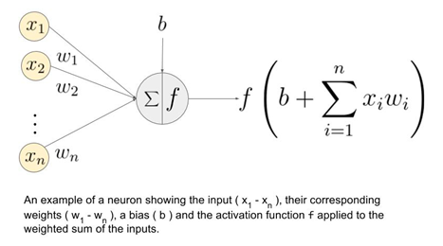
Gradients in DNN
These parameters (weights, bias) are exactly the numerical values ​​that we’ll try to adjust by training the network with an already labeled dataset.
Final result: Model built from training data, able to make predictions over future samples.

Slide 16
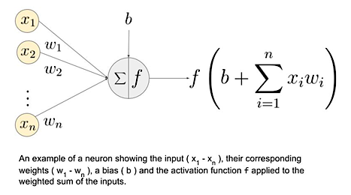
Parameters Initialization in DNN
If we start from scratch (without a pre-trained model), which parameters are initialized for a DNN once a neural network is chosen
Weights, Bias
How?
Random weight Initialization: to help our network, breaking its symmetry.
Goal is to prevent all neurons in a layer from learning the same thing.
Weights for each layer usually generated using a normal distribution of zero mean and 1/n or 2/n variance (where n is the number of entries).
value for variance depends on activation function placed at the output of the neuron (we’ll use 2/n for ReLU).
Initialize biases to zero.

Slide 17
Optimization Algorithm
Next STEP: Proceed iteratively by following an optimization algorithm.
Goal : minimize difference between (actual – estimate) output

Slide 18
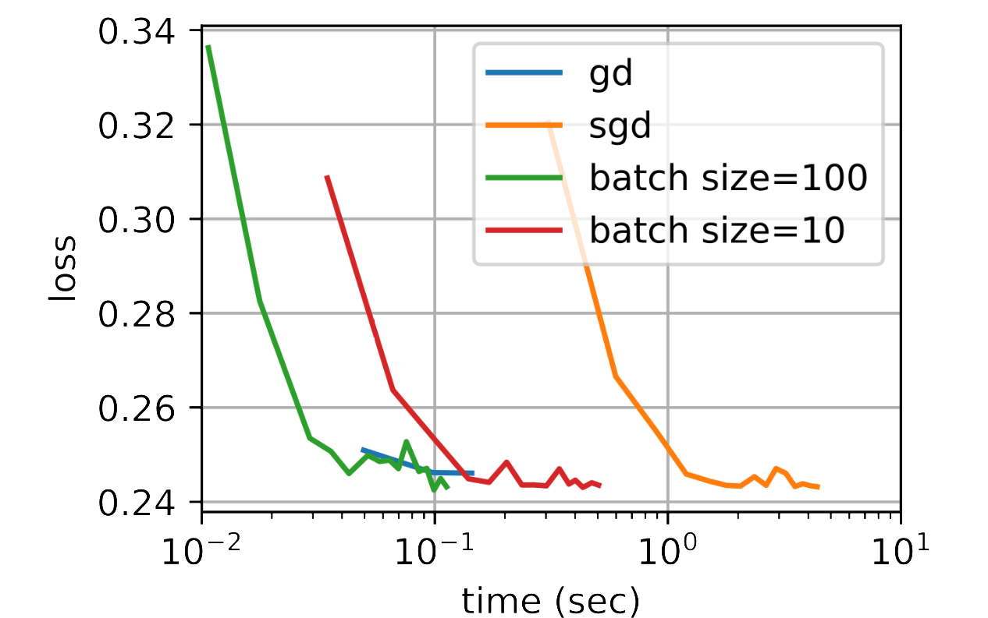
Gradient
Gradient is a numeric calculation allowing us to know how to adjust the parameters of a network in such a way that its output deviation is minimized.
Different versions - Batch, Stochastic, mini-batch..

Slide 19
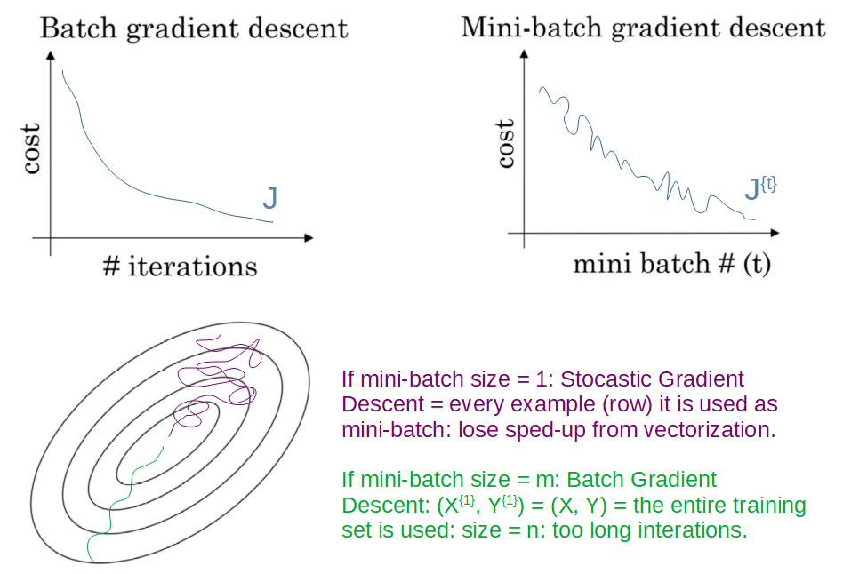
Gradient Descent - Algorithm
Gradient Descent algorithm using mini-batch:
N random samples from a previously labeled training dataset (we have the actual output).
Forward Propagation - Calculations on each layer, obtain predictions at output.
Evaluate loss function
Calculate gradient as the multi-variable derivative of loss function with respect to all the network parameters.
Graphically - slope of the tangent line to the loss function at the current point.
Mathematically - vector that gives the direction in which loss function increases faster,
so move in opposite direction to minimize it.

Slide 20
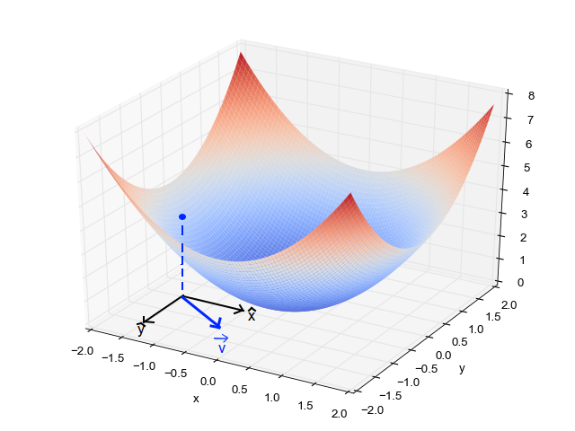
Gradient Descent
Let’s think of a few dimensions to visualize it. Imagine a network with only 2 parameters, so we could represent the loss function in 3 dimensions (XY plane for the parameter values, Z plane for the loss value). The gradient in this case would be a vector with 2 components (one on the X axis and one on the Y axis), pointing in a direction in the XY plane where we would move the parameters if we wanted to increase the loss as fast as we could. Its module will be greater the steeper the tangent’s slope is at the point at which it’s calculated; therefore, the closer we are to a minimum of the loss function the smaller its module will be (at a minimum the slope is zero). So the idea is to move in the opposite direction to the gradient, trying to reach the global minimum:

Slide 21
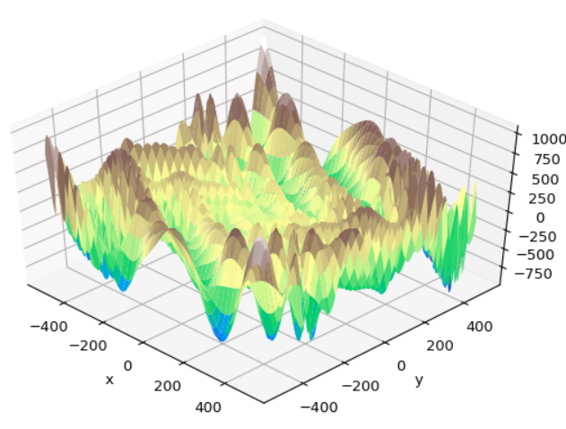
Gradient Descent – loss f(x)
Also, loss functions are much more complex
don’t have 2 parameters or dimensions; maybe it’s millions.
surface of function may present local minimums that in training could be easily confused with global minimum.

Slide 22
Gradient Descent
How to measure true impact of a first layer parameter’s variation on the final loss knowing this change affects all neurons in successive layers too?

Slide 23
Gradient Descent - BP
Back-propagation (or backward propagation)
Algorithm starts by calculating the partial derivatives of the loss function with respect to the parameters of last layer
Parameters of last layer don’t influence over any other network parameters. This isn’t a complicated calculation thanks to the chain rule.
Once derivatives are obtained, we move on to the previous layer, and we calculate the partial derivatives of the loss function, but now with respect to the parameters of this layer, something that we have partly solved thanks again to the chain rule.
Continue progressing backwards, until we reach the beginning of the network.

Slide 24
Gradient Descent - BP
Chain rule

Slide 25
Gradient Descent - BP
Update network parameters
subtracting corresponding gradient value from their current values, multiplied by a learning rate.
adjust magnitude of steps
Repeat until loss value and output metrics don’t start to steadily worsen

Slide 26
Reaching Global Minimum in GD
How to prevent loss getting worse?
Reach global minimum of loss function..How?
AVOID:
bouncing around it
sunk in a local minimum
stuck in a “saddle point” (local minimum in one dimension, maximum local in another)
Optimize learning rate by deciding:
Its value – Not too high (possible oscillations) or too low (slow, more iterations)

Slide 27
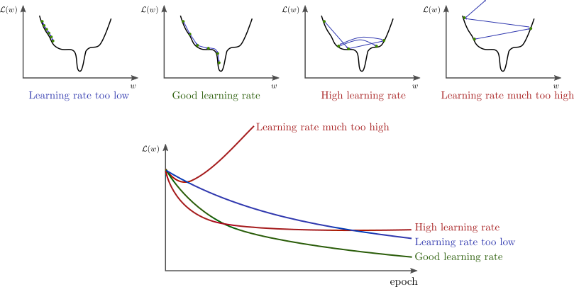
Optimizing Learning Curve

Slide 28
Vanishing/Exploding Gradients Problems
Vanishing Gradients: When gradients get increasingly smaller as the algorithm progresses down to the lower layers.
Exploding Gradients: When gradients get increasingly large as the algorithm progresses down to the lower layers.
Useful sources:
https://stats.stackexchange.com/questions/432300/help-understanding-vanishing-and-exploding-gradients
https://www.analyticsvidhya.com/blog/2021/06/the-challenge-of-vanishing-exploding-gradients-in-deep-neural-networks/
https://www.youtube.com/watch?v=qss30DuhbCo&ab_channel=intrigano

Slide 29
Overfitting
Train for too many epochs (an epoch is a full cycle of the algorithm in which the network sees all available samples once).
Very high epochs implies -> same samples processed too many times causing overfitting
Cause: small dataset compared to network size OR learning rate too small not allowing optimization of parameters quickly enough.
Notes:
Cause: small dataset compared to network size (if the number of training samples is much smaller than the number of parameters or degrees of freedom in the network), but also by a learning rate being too small and not allowing us to optimize the parameters quickly enough.

Slide 30
Vanishing/Exploding Gradients Problems
>> What this means for the weights?
>> GD update leaves weights of lower layer connections unchanged, and training never converges to a good solution. This is called the vanishing gradients problem.
For Exploding Gradients: Gradients can grow bigger and bigger, so many layers get insanely
large weight updates and the algorithm diverges.
More generally, deep neural networks suffer from unstable gradients; different layers may learn at
widely different speeds.

Slide 31
Gradients Problems – past and present
One of the reasons why deep neural networks were mostly abandoned for a long time…Until 2010..
Paper titled “Understanding the Difficulty of Training Deep Feedforward Neural Networks” by Xavier Glorot and Yoshua Bengio
Main contribution of paper:
Found a combination of logistic sigmoid activation function and weight initialization technique - random initialization using a normal distribution (mean = 0, std dev = 1)
Proved that with this activation function and this initialization scheme
variance of outputs of each layer >> variance of its inputs
During forward propagation, variance keeps increasing after each layer until activation function saturates at top layers
made worse by logistic function with mean of 0.5, not 0

Slide 32
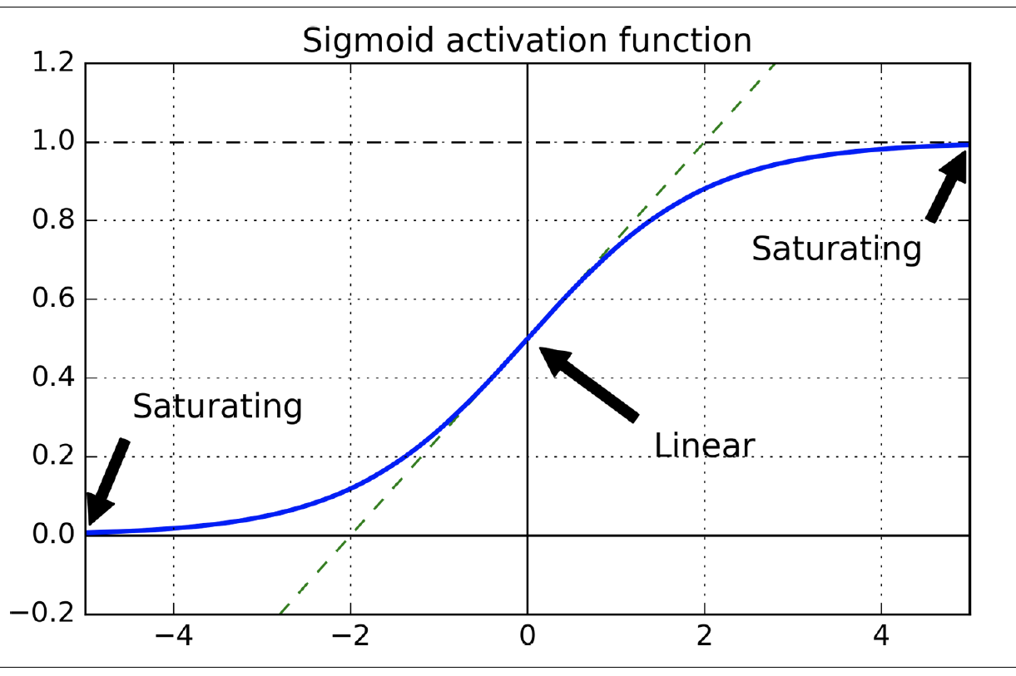
Problem paper addressed:
When inputs become large (negative or positive)
function saturates at 0 or 1
derivative extremely close to 0.
When backpropagation kicks in
Virtually no gradient to propagate back through the network,
what little gradient exists gets diluted as backpropagation progresses
nothing left for lower layers
Logistic activation function saturation

Slide 33
Glorot and He Initialization
Paper proposed a way to significantly alleviate this problem. How?
signal should flow properly in both directions: forward direction when making predictions, and reverse direction when backpropagating gradients
We don’t want signal to die out, nor do we want it to explode and saturate

Slide 34
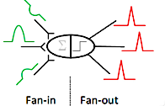
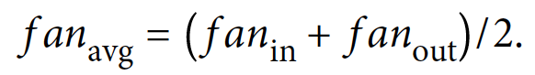
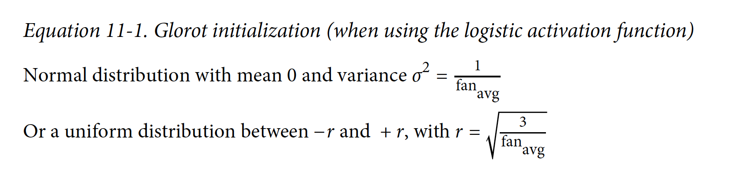
Glorot and He Initialization
Signal should flow in both directions
variance of outputs of each layer to be equal to the variance of its inputs
gradients to have equal variance before and after flowing through a layer in the reverse direction
Note: Not possible to guarantee both unless the layer has an equal number of inputs (fan-in) and neurons.
Solution worked very well in practice. See equation.

Slide 35
Glorot and He Initialization
Using Glorot initialization can speed up training considerably, and it is one of the tricks that led to the current success of
Deep Learning

Slide 36
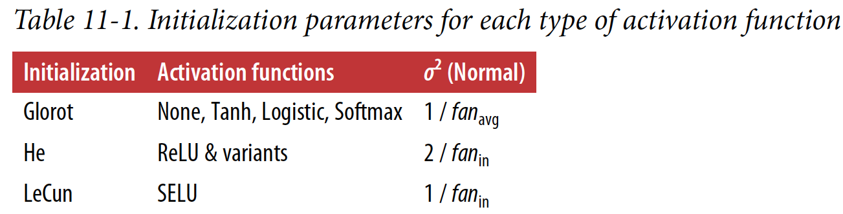
Other activation functions
Strategies differ only by scale of the variance and whether they use fan_{avg} or fan_{in} (see Table)
- initialization strategy for ReLU activation function sometimes called He initialization (after
the last name of its author).

Slide 37
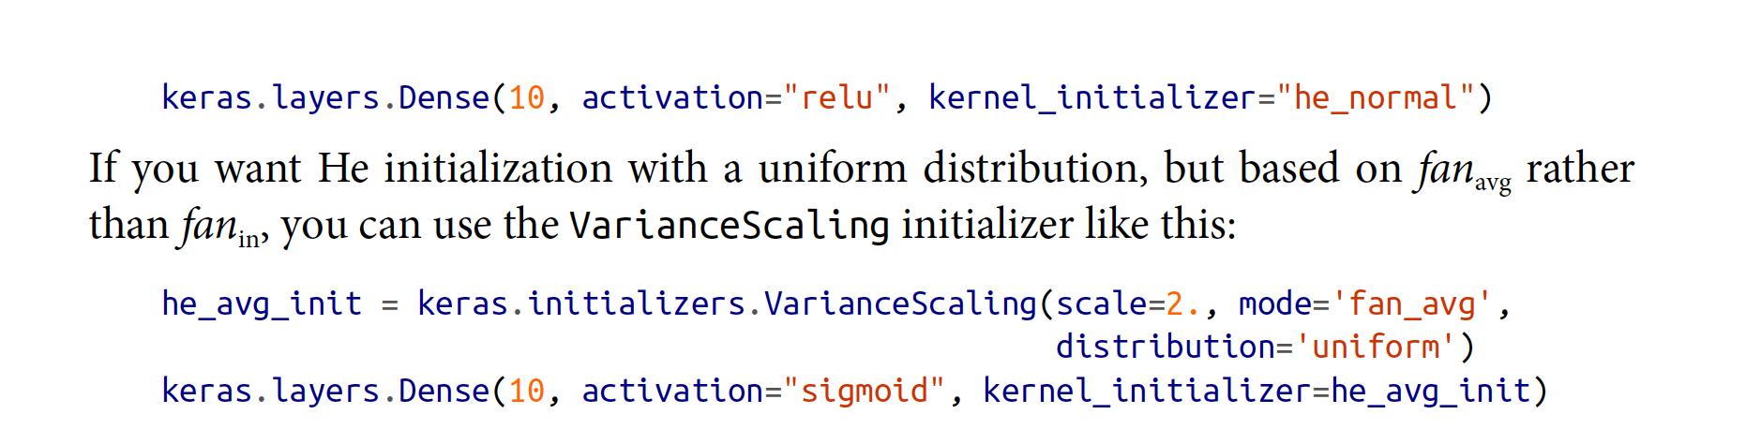
In Practice
By default, Keras uses Glorot initialization with a uniform distribution. You can
change this to He initialization by setting kernel_initializer="he_uniform" or ker
nel_initializer="he_normal" when creating a layer, like this:

Slide 38
ReLU
ReLU activation function works better than He :
it does not saturate for positive values (and also because it is quite fast to compute)
Challenges with ReLU
during training, some neurons effectively die, meaning they stop outputting anything other than 0
Example: you may find that half of your network’s neurons are dead, especially if you used a large learning rate. A neuron dies when its weights get tweaked in such a way that the weighted sum of its inputs are negative for all instances in the training set. When this happens, it just keeps outputting 0s, and gradient descent does not affect it anymore since the gradient of the ReLU function is 0 when its input is negative.
Dying ReLUs

Slide 39
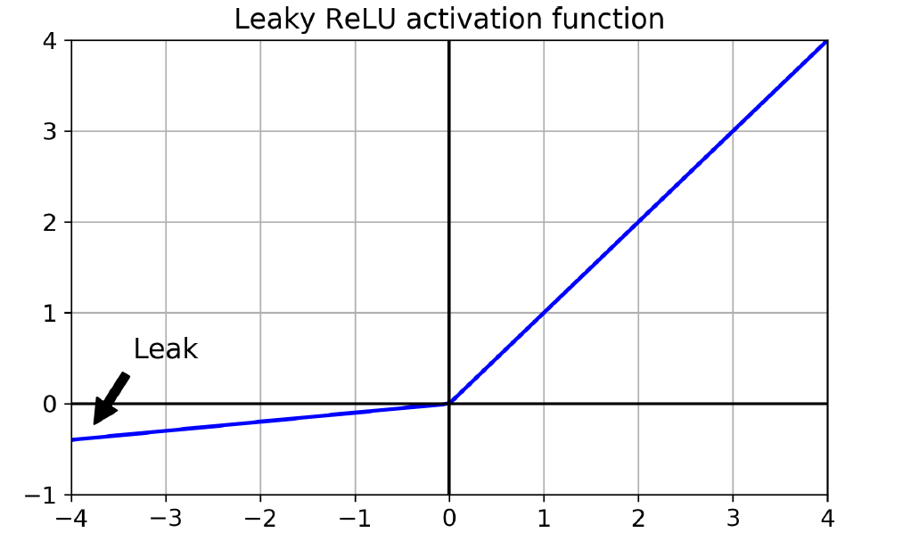
Leaky ReLU
To solve this problem, use a variant of the ReLU function - leaky ReLU
LeakyReLU_{α}(z) = max(αz, z)
α – hyperparameter that defines how much the function “leaks”
- it is the slope of the function for z < 0
- typically set to 0.01
Small slope – ensures that leaky ReLUs never die

Slide 40
Leaky ReLU
NOTE: A 2015 paper compared several variants of the ReLU activation function. Concluded:
leaky variants always outperformed strict ReLU activation function
Example, setting α = 0.2 (huge leak) resulted in better performance than α = 0.01 (small leak).
Other conclusions in book – Hands On ML ed.2, section “Nonsaturating Activation Functions”

Slide 41
Batch Normalization
Let’s discuss a new challenge with ReLUs or it’s variants
While, vanishing/exploding gradients problems may be solved at the beginning of training, it doesn’t guarantee that they won’t come back during training.
To address this, we use a technique called Batch Normalization
Proposed in 2015 by Sergey Ioffe and Christian Szegedy
Lets model learn optimal scale and mean of each of the layer’s inputs
Adds an operation just before or after activation function of each hidden layer
Zero-centers and normalizing each input
Uses two parameter vectors per layer: one for scaling, other for shifting

Slide 42
How to add BN Layer
For input layer – no need to standardize training set (e.g., using a StandardScaler)
BN layer will do it for you (well, approximately, since it only looks at one batch at a time, and it can also rescale and shift each input feature)
To zero-center and normalize inputs, the algorithm estimates each input’s mean and standard deviation. It does so by evaluating the mean and standard deviation of each input over the current mini-batch (hence the name “Batch Normalization”).

Slide 43
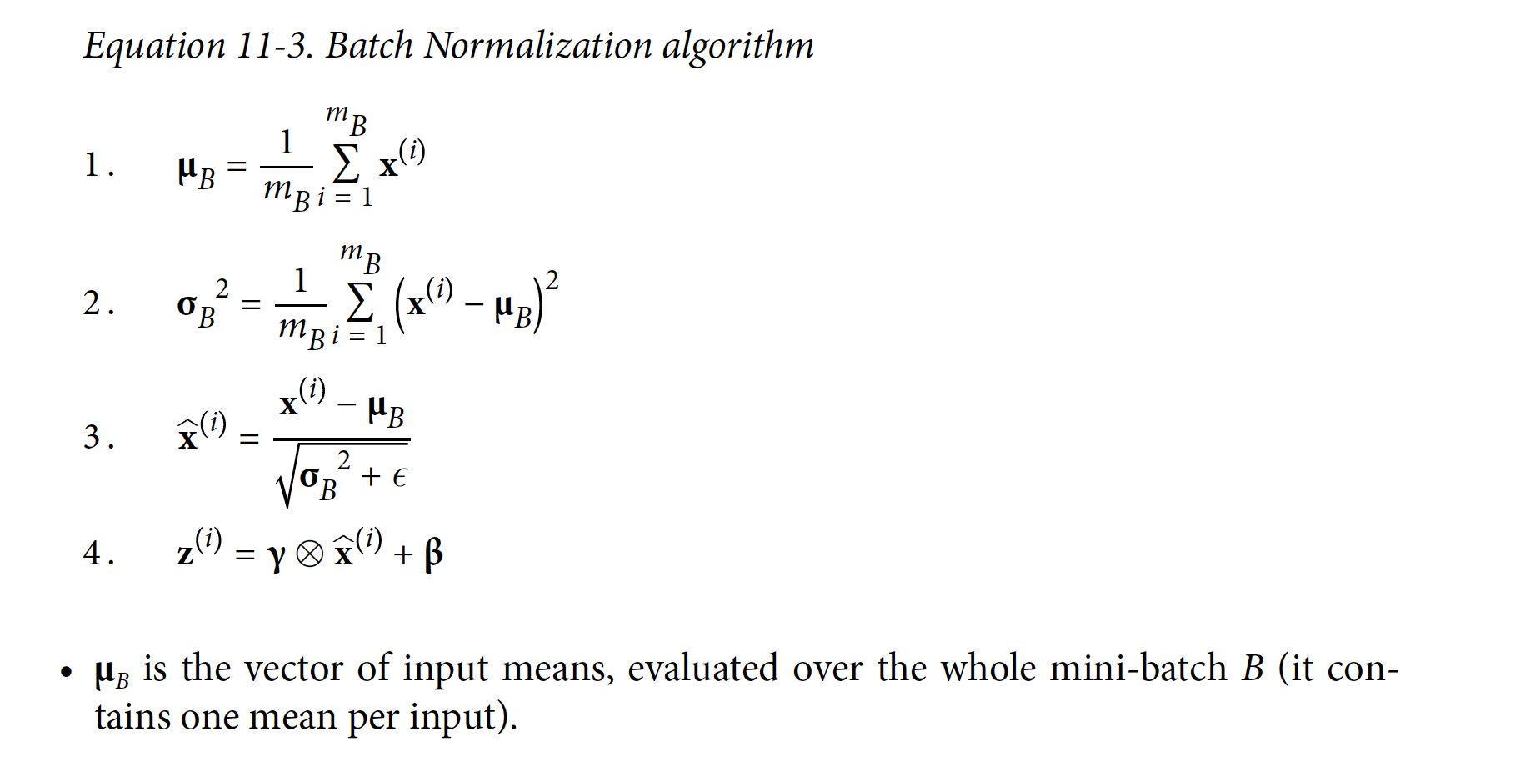
Batch Normalization Summary

Slide 44
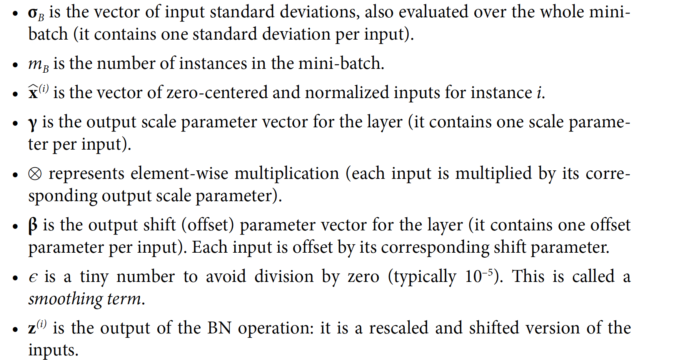

Slide 45
Gradient Clipping
Another popular technique to lessen exploding gradients problem:
clip the gradients during backpropagation so that they never exceed some threshold
Technique imost often used in recurrent neural networks, as Batch Normalization is tricky to use in RNNs
In Keras, implementing Gradient Clipping is just a matter of setting the clipvalue or
clipnorm argument when creating an optimizer. For example:

Slide 46
Gradient Clipping
Clips every component of the gradient vector to a value between –1.0 and 1.0. This means that all the partial derivatives of the loss (with regards to each and every trainable parameter) will be clipped between –1.0 and 1.0.
This threshold is tunable
Eg: original gradient vector is [0.9, 100.0]
once you clip it by value, you get [0.9, 1.0],

Slide 47
Reusing Pretrained Layers

Slide 48
Reusing Pretrained Layers
Generally, not a good idea to train a very large DNN from scratch:
Always try to find an existing neural network that accomplishes a similar task to the one you are trying to tackle
Reuse the lower layers of this network: this is called transfer learning.
Speeds up training considerably, and will also require much less training data.
E.g.: DNN was trained to classify pictures into 100 different categories, including animals, plants, vehicles, and everyday objects. You now want to train a DNN to classify specific types of vehicles. These tasks are very similar, even partly overlapping, so you should try to reuse parts of the first network.

Slide 49
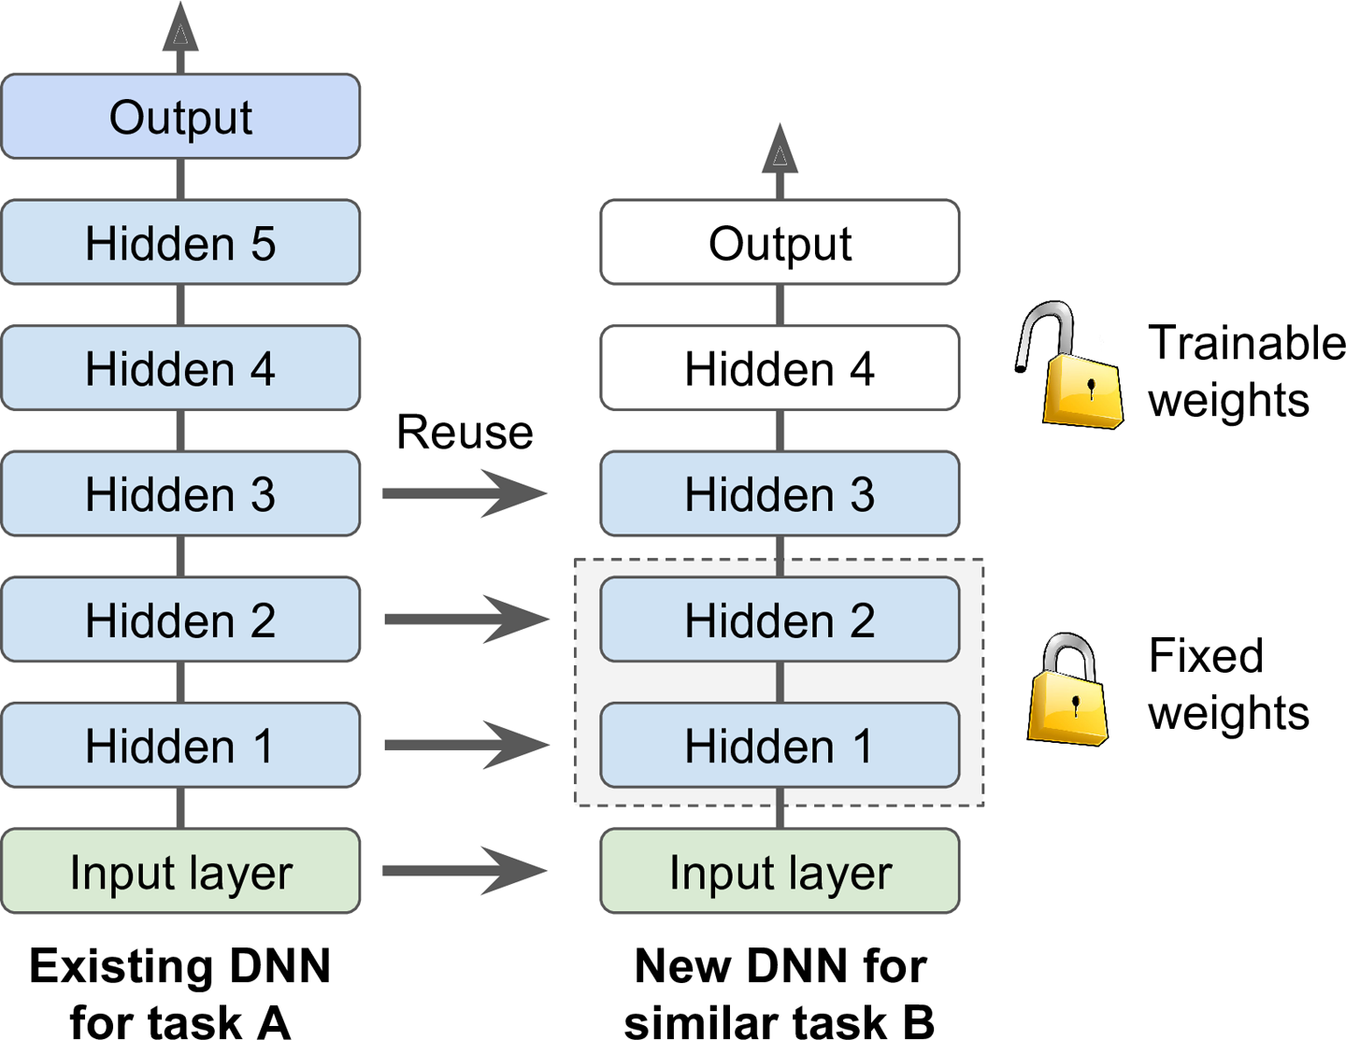


Reusing Pretrained Layers
If input pictures of your new task don’t have the same size as the ones used in the original task, add a preprocessing step to resize them to the size expected by the original model.
Transfer learning will work best when the inputs have similar low-level features.
Reusing pretrained layers

Slide 50
Transfer Learning With Keras
Load model A, and create a new model based on the model A’s layers. Let’s reuse all layers except for the output layer:
model_A and model_B_on_A now share some layers. When you train model_B_on_A, it will also affect model_A. If you want to avoid that, you need to clone model_A before you reuse its layers. To do this, you must clone model A’s architecture, then copy its weights (since clone_model() does not clone the weights):

Slide 51
Transfer Learning With Keras contd..
Train model_B_on_A for task B
Watch out: Since new output layer was initialized randomly, it will make large errors, at least during the first few epochs
Large error gradients can wreck the reused weights.
To avoid this, one approach is to freeze the reused layers during the first few epochs, giving the new layer some time to learn reasonable weights.
set every layer’s train able attribute to False and compile the model:

Slide 52
Train model for a few epochs, unfreeze the reused layers by re compiling the model
Continue training to fine-tune reused layers for task B.
good idea to reduce lr to avoid damaging reused weights:

Slide 53
This model’s test accuracy is 99.25%
This may not work with all NNs
Transfer learning does not work very well with small dense networks: it works best with deep convolutional neural networks.

Slide 54
Coding Exercise

Slide 55
Attributions
Some of these slides are based on material from Hands-On Machine Learning, 2nd Edition, some search on Internet...
Coding exercise are from the text book and from Kaggle.com (it’s best place to practice!)

